Slide 1
2/04 Update

Slide 2
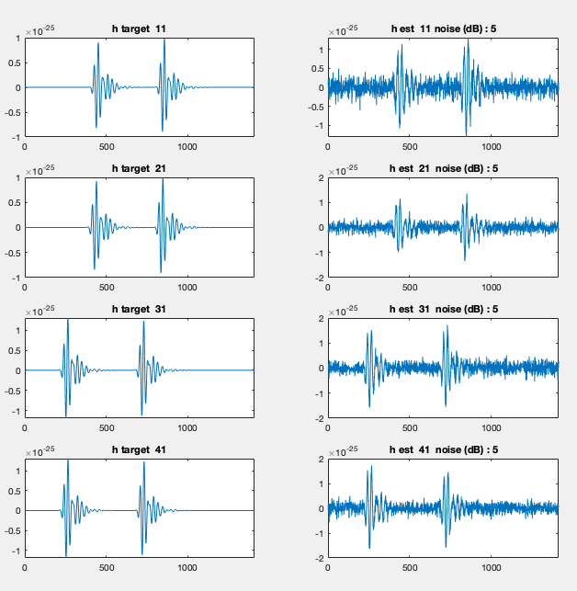
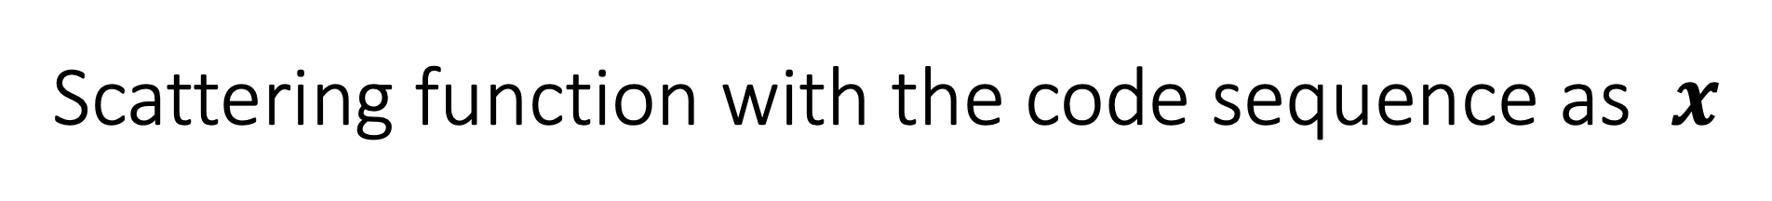
Scattering function with the code sequence as $x$

Slide 3
Beamforming after match filter (no noise)

Slide 4
Beamforming without match filter
5dB
inf

